Slide 1
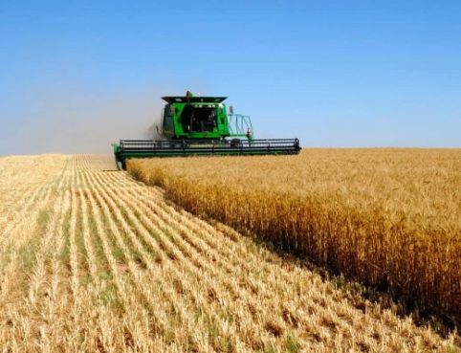
GROUP OF COMPANIES «PRAVIO»
2019

Slide 2
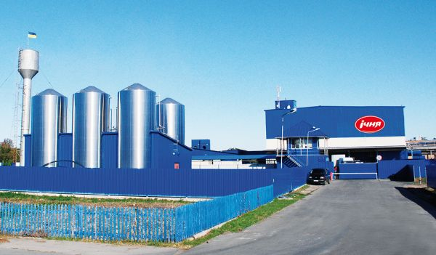
Group of companies PRAVIO
PRAVIO - is a mutually integrated businesses
consolidated into holding company – producer of canned dairy products
Agriculture and farming
Dairy business
JSC Ichnya Condensed Milk Company
LLC Pravagro
LLC Proviant

Slide 3
Group of companies PRAVIO
Agriculture and farming
In 2018, Ukraine received a record harvest of grain - 70.1 million tons, which will allow exports of 47-50 million tons of grain. Including our holding, which exports about 70 thousand tons of grain annually. The main export directions are traditional - the EU countries, as well as North Africa and Asia.
Pravio Agricultural holding owns a land bank of 11.5 thousand hectares, which is concentrated in the north of Ukraine in the Chernihiv region.
Own machinery and equipment: tractors, cultivators, seeders, bunker reloaders, sprayers; mineral fertilizer spreaders; telescopic loader and others.
In the structure of companies there is an elevator complex for drying grain with a capacity of 1200 t / day.
The holding is equipped with its own storage capacity of grain in the amount of 75 thousand tons.

Slide 4
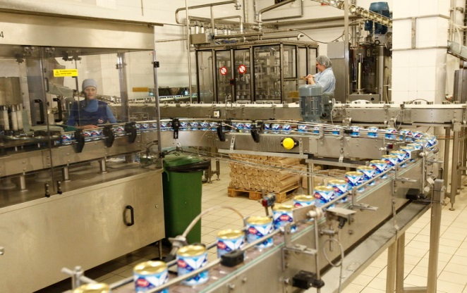
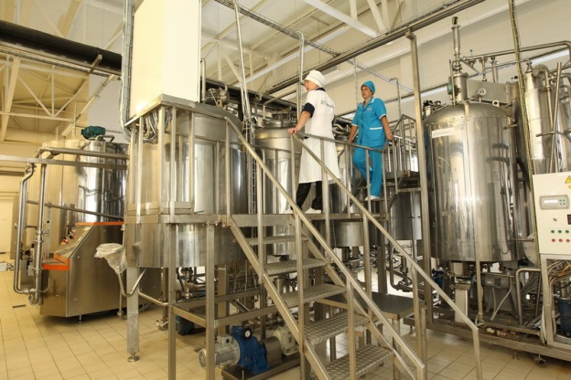
Group of companies PRAVIO
PRAVIO - is a mutually integrated businesses
consolidated into holding company – producer of canned dairy products
JSC Ichnya Condensed Milk Company - this is a European-level milk processing plant in Ukraine, which is the undisputed leader in the Ukrainian market for the production of condensed milk
JSC Ichnya Condensed Milk Company - modern production complex, designed and built on the basis of modern technologies that meet the most stringent requirements of world standards.

Slide 5
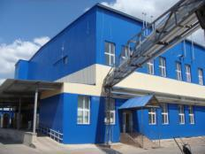
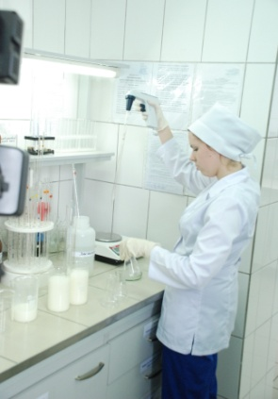
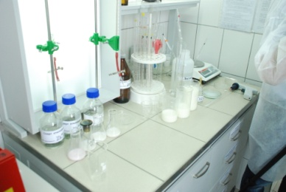
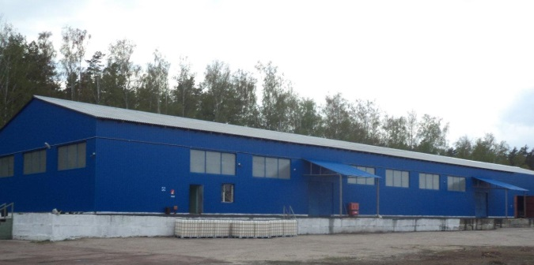
Assets of PRAVIO: Ichnya Condensed Milk Company
Production facilities
Location: town of Ichnya, Chernigiv region
Total area of land plot: 3,8 hectares
Total space area: 5 246 square meters
Space area of canning
manufactory: 800 square meters (fully renovated)
Also renovated according to high International standards:
manufacturing laboratory, testing room, administrative facilities, systems of heating, sewerage, electricity supply
Storage facilities
Location: 5 km from production site
Total area of the plot : 10,5 hectares
Total space area: 6 433 square meters
Sweetened condensed milk production (market share by production volume – 23 %)
LLC Proviant - export to more than 70 countries abroad
and distribution in Ukraine

Slide 6
Statistics
70% of total production is exported to more than 65 countries of the world
30% of the total volume of production is the domestic market
The volume of production at the moment is 80 tons/day of finished goods
Sales volume - 5 million pcs / month
We occupy 60% of Ukraine's total condensed milk exports
The remaining 40% are shared among 6 manufacturers
Exports in April 2019 amounted to 1,400 tons of finished products (out of a total of 2,200 tons)

Slide 7
PRAVIO: Production Volumes in 2014-2018
Production capacities
(in provisional quantity):
per month 8 500 000 tins
per year 102 000 000 tins* * (since 2018)
Actual production volumes
for the recent years:
2018 65 970 000 tins
2017 64 460 000 tins
2016 63 540 000 tins
2015 61 890 000 tins
2014 60 330 000 tins
2014 2015 2016 2017 2018

Slide 8
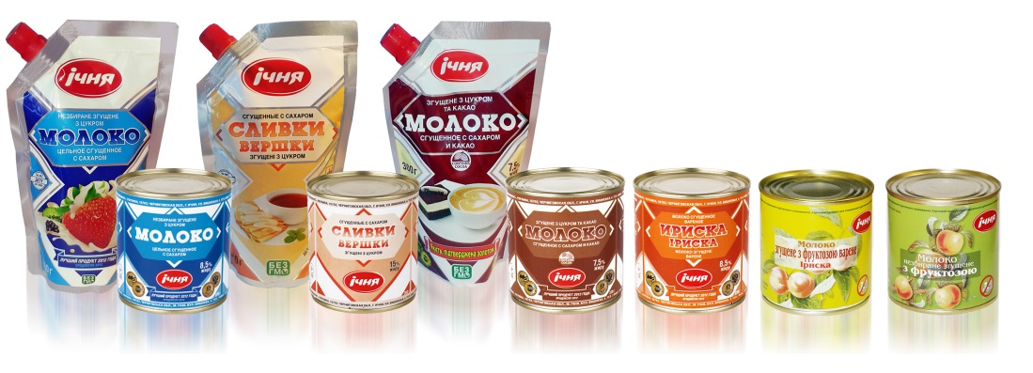
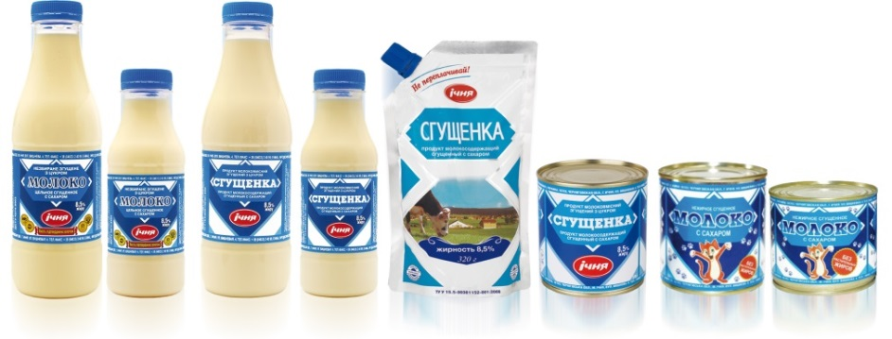
Supply For Retail Consumers in Ukraine
Products for premium
segment
Products for medium
price segment
Products for low price segment

Slide 9
Thank you for your attention!
Deputy CEO Serhii Zaporoshchuk +380504652083

