Slide 1
UKRAINIAN
PRODUCER & EXPORTER

Slide 2
About the Company
Power Nuts Group is international producer and exporter of walnuts from Ukraine.
Today, our leading business marketplaces located in Europe and CIS, and we are continually expanding the territory. The range of countries we operate in is the strength of our business.
We have a full walnut processing cycle with a capacity of 1500 MT/year. The process starts with clearing the kernel from dust and membranes, sorts into fractions and types by color on a photo separator, dry in a drying chamber, and packing. The presence of industrial refrigerators allows you to work during the year.
http://powernuts.group/
2

Slide 3
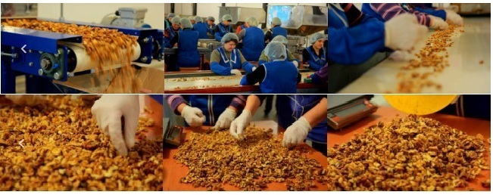
Production
Power Nuts Group is international producer and exporter of walnuts kernel with a capacity 1500 MT/year. We combine our unique quality with proactive approach to the Customer needs.
6

Slide 4
We Guarantee
The highest quality products and the most delicious taste of walnut all over the world.
Competitive and flexibility of commercial conditions.
Precise whole walnuts calibration.
Organic kernels according to European standards.
Full package of accompanying documents and certificates.
Fast border crossing and prompt delivery to your country.
Packaging according to your demands.
7

Slide 5
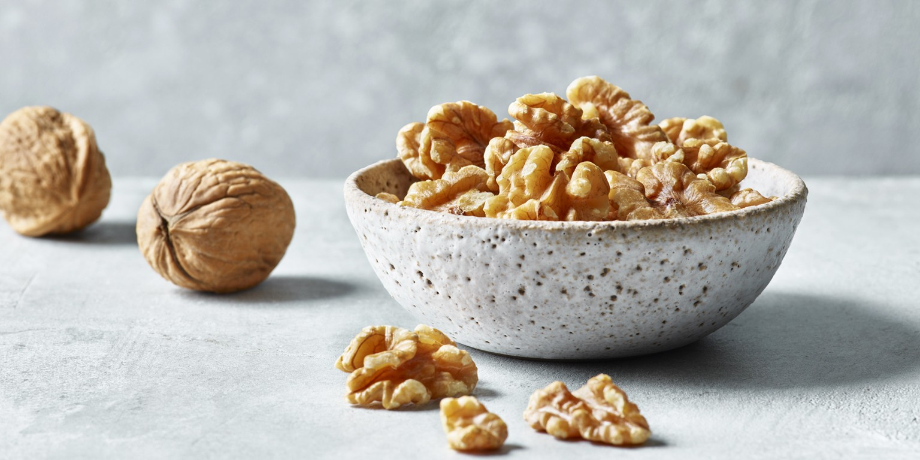
Assortment Range
http://powernuts.group/
8

Slide 6
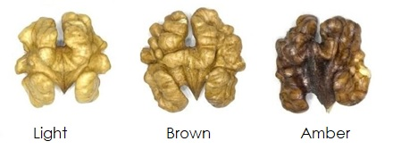
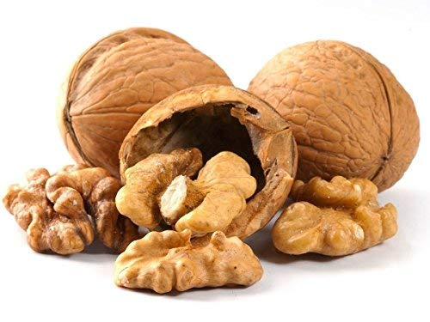
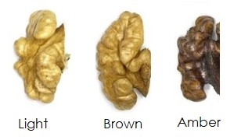
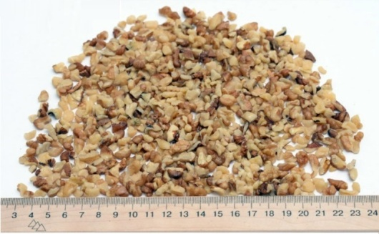
Assortment Range
WALNUT KERNELS HALVES (1/2)
WALNUT ROUND CALIBRE 28+
HALVES (MIN 90%) + QUARTERS (MAX 10%)
KERNEL OUTPUT: 40-42%. ~55%L ~30%B, ~15%A
WALNUT KERNELS QUARTERS (1/4)
WALNUT KERNELS MIX
QUARTERS (MIN 90%) + ONE -EIGHTS (MAX 10%)
KERNERLS & COLOR MIX 1/2 + 1/4
9

Slide 7
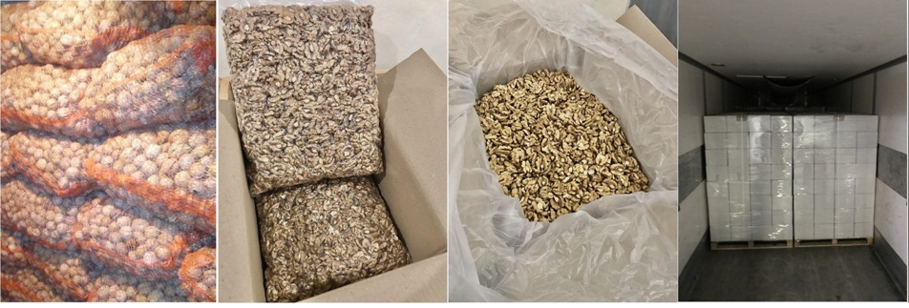
Assortment Range. Packaging
10

Slide 8
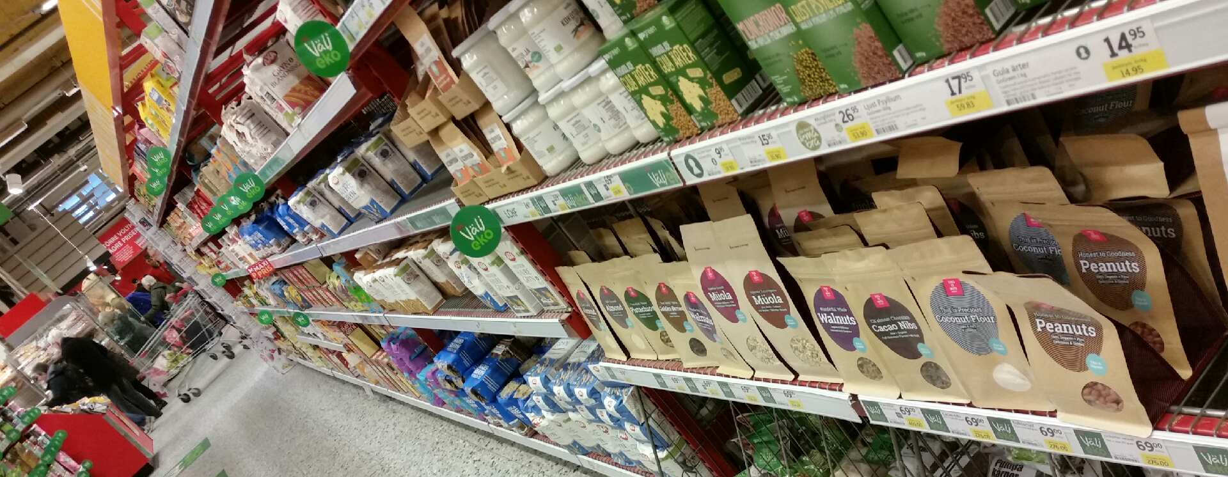
We Offer To Retail Sector
12

Slide 9
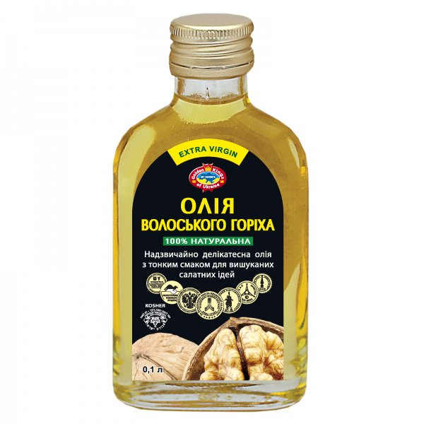
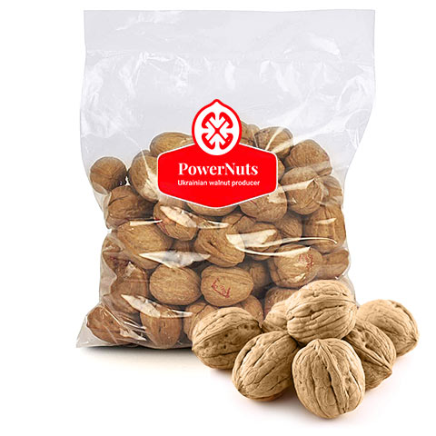
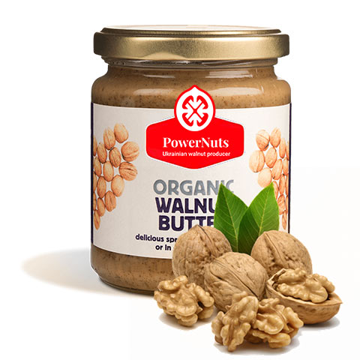
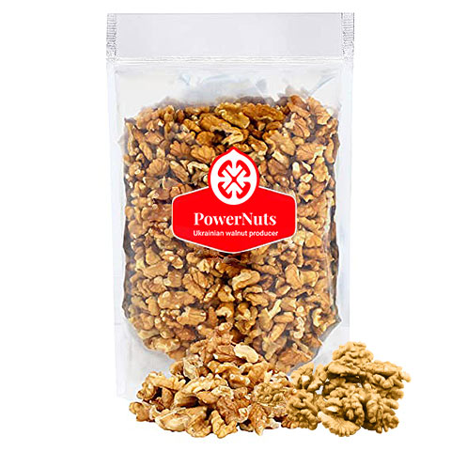
Packaging Solutions for FMCG
13

Slide 10
We Offer to B2B Customers
A.
We offer own brand “Power Nuts” and Private Label. The small retailers have the ability to move quickly to get a private label product in production in response to rising market demand for a new feature.
Creating and development of unique Modern Packaging and New Products, based on international market research and analysis.
Production and stock availability on regional warehouses.
B.
C.
14

Slide 11
Online & Offline Retail Partners
15

Slide 12
Contact Person: Volodymyr Tyshchuk +38 050 351 90 38 vtishuk128@gmail.com

